Slide 1
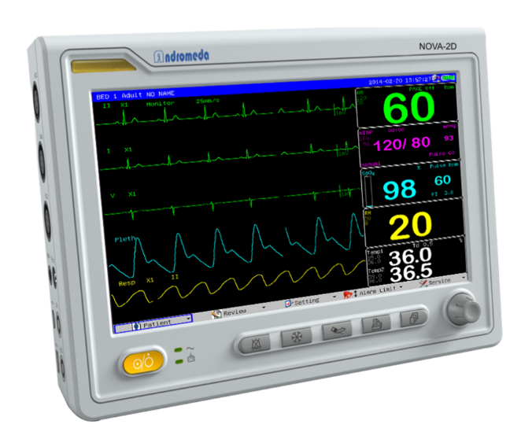
Physiological Monitor
principles of operation
  function
  use
  scientific principles
construction
  components
  system diagram
  inputs/outputs
troubleshooting
  identifying common faults
  replacing components
  rectifying faults
safety considerations
  user and patient safety
  electrical safety
performance monitoring
  calibration
  quality assurance and control
18.1.5 Physiological Monitor
Unit C 18.1 Maintaining cardiovascular and monitoring equipment
Module 279 19 C Medical Instrumentation II
©
dr. Chris R. Mol, BME, NORTEC, 2017

Slide 2
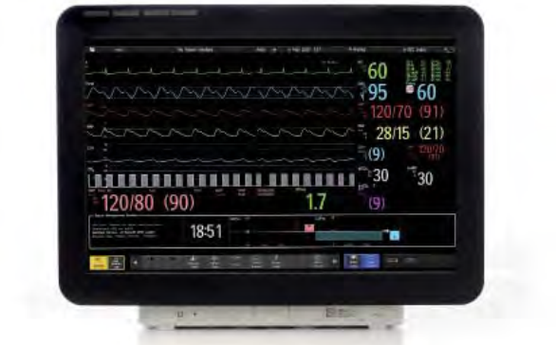
Function
Continuous monitoring provides information to the medical and nursing staff about the physiologic condition of the patient. Using this information, the clinical staff can better evaluate a patient’s condition and make good treatment decisions.
Depending on the condition of the patient and the type of monitoring equipment used, measurements can include:
  ECG and heart rate
  respiratory rate
  SpO2
  noninvasive blood pressure (NIBP)
  body temperature
  airway gas concentrations
  invasive blood pressure (IBP)
  mixed venous oxygenation (SvO2)
  cardiac output
  ETCO2 (concentration of carbon dioxide)
  intracranial pressure
  airway gas concentrations
}
most popular
the monitor provides an overview of condition of the patient (‘cockpit’)
©
Physiological Monitor
dr. Chris R. Mol, BME, NORTEC, 2017

Slide 3

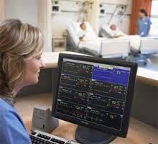
Use
Physiological Monitoring is used in the Operating room (OR), Intensive / Critical Care, neonatal department, ambulance, and other life critical situations. There are different models for the various applications.
Physiological data are displayed continuously on a screen as time signals. They may be accompanied by numbers calculated from these signals, such as maximum, minimum and average values, pulse and respiratory frequencies, and so on.
Next to the monitors at the patient bed side, many physiologic monitoring systems include a central station capable of displaying ECG waveforms and other information from any bedside within the system/department. Many are equipped with alarms that are coordinated with those at the bedside monitor. This allows a single nurse to monitor multiple patients at the same time. Central monitoring stations can receive signals from bedside
monitors via cables or wireless.
©
Physiological Monitor
dr. Chris R. Mol, BME, NORTEC, 2017

Slide 4
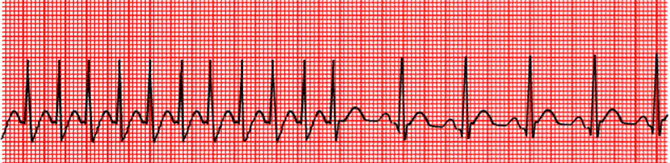
Scientific Principles: ECG monitoring
ECG monitoring
The skin surface ECG measures the electrical activity of the patient’s heart and reveals major changes in heart rate and cardiac rhythm, including ‘arrhythmias’ and ‘a-systole’.
ECG disturbances can be caused by changes in:
  electrolyte concentrations
  acid-base balance,
  increased metabolic activity,
  neurologic changes,
  hypoxemia,
  hypothermia,
  ischemia, and
  drug reactions.
Note: this relates to the use of the ECG for monitoring not for diagnosis !
©
Physiological Monitor
dr. Chris R. Mol, BME, NORTEC, 2017

Slide 5
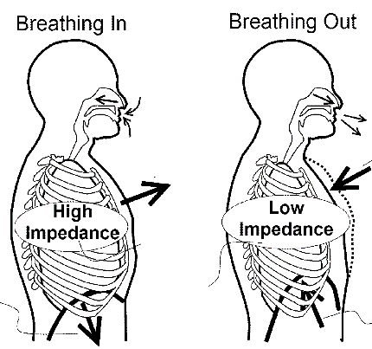
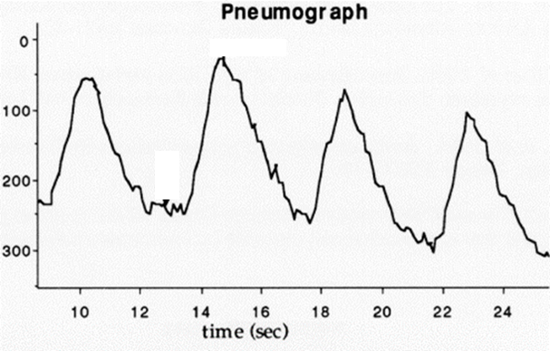
Scientific Principles: Respiratory rate
The most common method way to measure respiratory rate is impedance pneumo-graphy. In this method, high frequency, low voltage ac signals are applied across the chest through the (ECG) electrodes and measure the change in electrical impedance as the chest expands and relaxes during respiration. Rib cage expansion and the movement of diaphragm contribute to this impedance change. The change in impedance creates a change in voltage across the signal, which is interpreted as a breath and displayed as a waveform and digital readout of the respiratory rate.
Respiratory rate is monitored on many patients. Neonatal respiratory rate monitoring is used primarily to detect apnea (cessation of breathing), a condition to which premature and low-birth-weight infants are particularly susceptible. For this, the respiratory rate monitor includes an apnea alarm that is triggered if no breaths are detected over a period of time predetermined by the user.
©
Physiological Monitor
dr. Chris R. Mol, BME, NORTEC, 2017

Slide 6
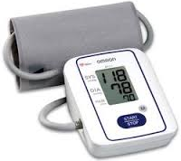
Scientific Principles: Blood Pressure
Blood pressure is the pressure exerted by the blood against the walls of the blood vessels. Blood pressure measurement indicates the status of the patient’s overall cardiac condition.
Cuff size, cuff placement, and artefacts are affecting accurate measurement of NIBP.
cuff
©
Physiological Monitor
dr. Chris R. Mol, BME, NORTEC, 2017

Slide 7
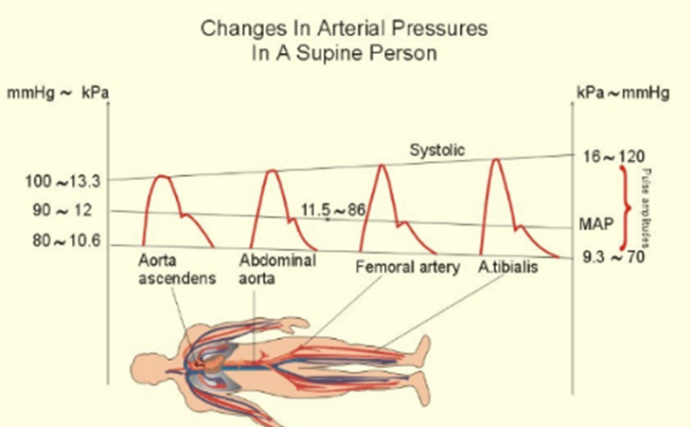
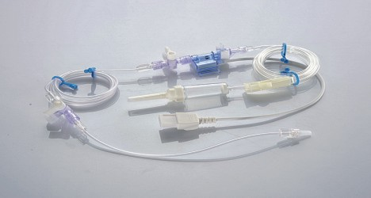
Scientific Principles: Invasive Blood Pressure
IBP is measured by a catheter inserted directly into the circulatory system. In neonates, the catheter is typically inserted directly into the umbilical vein.
A pressure transducer connected to the catheter converts the mechanical force exerted by the blood into an electrical signal, which is displayed graphically as pressure versus time on a monitor screen or numerically on a meter or digital display.
©
Physiological Monitor
dr. Chris R. Mol, BME, NORTEC, 2017

Slide 8
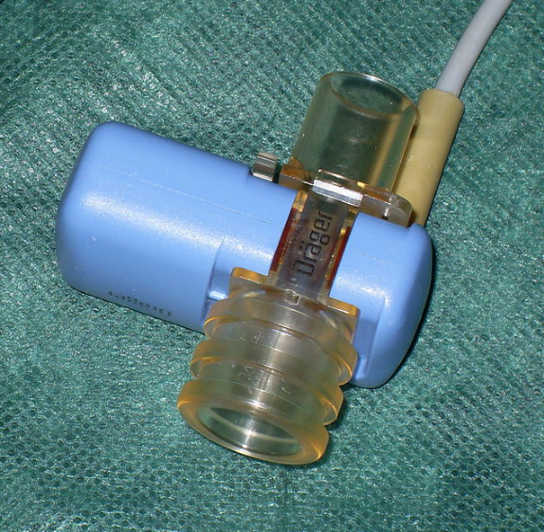
Scientific Principles: ETCO2
is the maximal concentration of carbon dioxide (CO2) at the end of an exhaled breath, which is expressed as a percentage of CO2.
The normal values are 5% to 6% CO2.
CO2 measurement (capnography) work on the principle that CO2 absorbs infrared radiation. A beam of infrared light is passed across the gas sample to fall on a sensor. The presence of CO2 in the gas leads to a reduction in the amount of light falling on the sensor, which changes the voltage in a circuit.
©
Physiological Monitor
dr. Chris R. Mol, BME, NORTEC, 2017

Slide 9
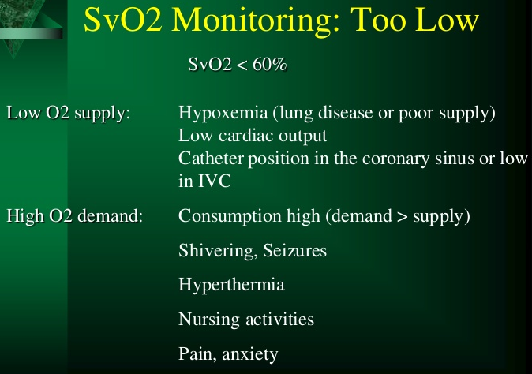
Scientific Principles: SvO2
Mixed venous oxygen saturation (SvO2) is the percentage of oxygen bound to hemoglobin in blood returning to the right side of the heart. It is measured from a blood sample that is drawn with a catheter from the pulmonary artery. SvO2 reflects the amount of oxygen "left over" after the tissues remove what they need.
Mixed venous oxygen saturation (SvO2) can help to determine whether the cardiac output and oxygen delivery is high enough to meet a patient's needs. It can be very useful if measured before and after changes are made to cardiac medications or mechanical ventilation, particularly in unstable patients.
Normal SvO2 is 60-80%.
SvO2 is most commonly monitored for very critically ill patients and trauma patients
©
Physiological Monitor
dr. Chris R. Mol, BME, NORTEC, 2017

Slide 10
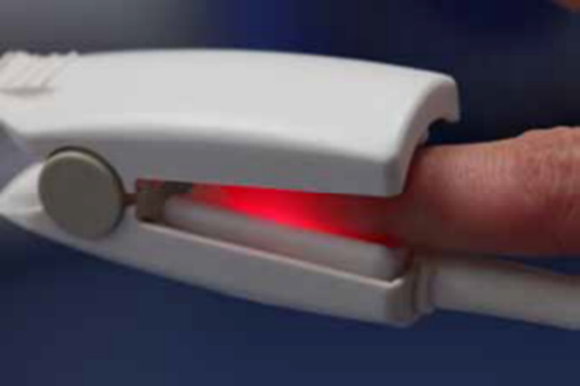
Scientific Principles: Pulse Oximetry
Pulse oximetry provides a rapid indication of a patient’s changing level of oxygenation, an indicator of effective ventilation.
Pulse oximetry allows continuous and instantaneous monitoring of SpO2 and may reduce the need for arterial puncture and laboratory blood-gas analysis.
Pulse oximetry provides a quick check of the ventilator status of neonates. It is especially helpful for monitoring neonates on oxygen (O2) therapy and is essential in caring for ventilator-dependent patients.
Pulse oximetry is based on principle that the red blood cells absorb different amounts of light depending on the amount of oxygen they contain. When light is transmitted through body tissue such as finger, it is absorbed differently by skin pigments, tissue, bone, arterial blood and venous blood. The measurement is derived using two wavelengths of light - one in the Red Region and one in Infrared.
©
Physiological Monitor
dr. Chris R. Mol, BME, NORTEC, 2017

Slide 11
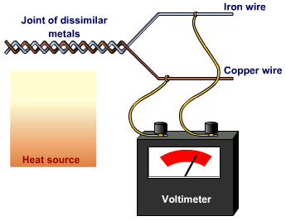
Scientific Principles: Body Temperature
Temperature is the measurement of the amount of heat present in a region of the body. Various region and tissues within the body have widely divergent temperatures and many factors can influence temperature change. Body temperature can indicate conditions such as infection, inflammation and antigenic responses (immune reactions) as well as effectiveness of treatment.
Monitoring body temperature is important in cases of hypothermia or hyperthermia, during general anesthesia, and especially during surgical procedures. Body temperature is also important in monitoring neonates because the body temperature reading of a neonate reflects the general metabolic condition and the presence of infection.
Body temperature is usually measured by a thermistor probe (a semicon-ductor whose resistance changes with temperature) that is inserted in the rectum or the esophagus.
Temperature can also be measured with a thermocouple, which is made of two dissimilar conductors joined at the junction. A voltage is generated when the junction is heated. The voltage generated is directly proportional to the temperature.
principle of thermocouple method
©
Physiological Monitor
dr. Chris R. Mol, BME, NORTEC, 2017

Slide 12
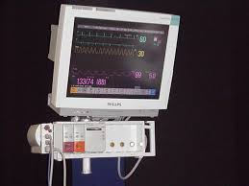
Construction
Physiological monitors can include a central station monitor that receives, consolidates, and displays the information and a set of monitors that are deployed near the patient (bedside monitors) to provide the required data from each patient
Physiologic monitors can be configured, modular, or both.
Configured monitors have all their capabilities already built-in.
Modular systems feature individual modules for each monitoring parameter or group of parameters.
Product specifications
Approx. dimensions (mm): 375 x 275 x 238
Approx. weight (kg): 10
Consumables: Batteries, cables, sensors/electrodes, cuffs
Price range (USD): 3,000 - 50,000
Typical product life time (years): 7-10
©
Physiological Monitor
dr. Chris R. Mol, BME, NORTEC, 2017

Slide 13
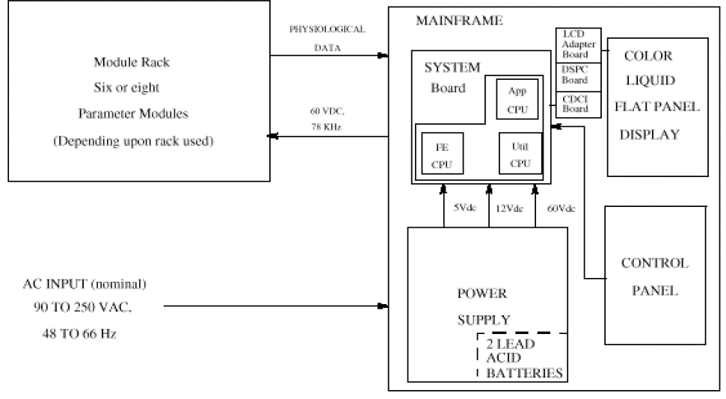
System Diagram
sensors
modular system
Battery- and line-powered units
©
Physiological Monitor
dr. Chris R. Mol, BME, NORTEC, 2017

Slide 14
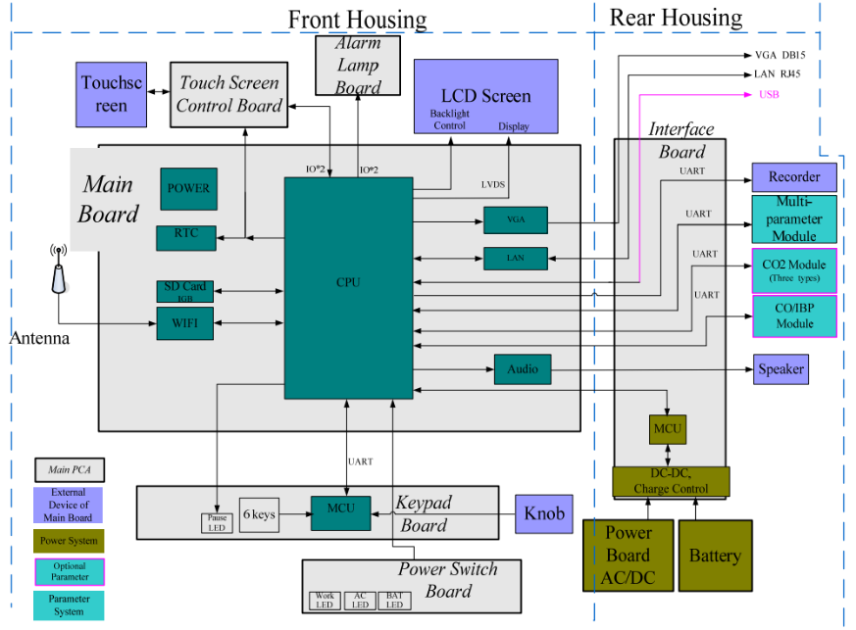
System Diagram of
Central Station
©
Physiological Monitor
dr. Chris R. Mol, BME, NORTEC, 2017

Slide 15
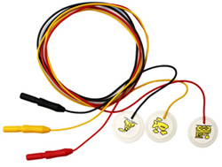
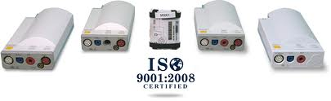
Components
modules
leads and electrodes
©
Physiological Monitor
dr. Chris R. Mol, BME, NORTEC, 2017

Slide 16
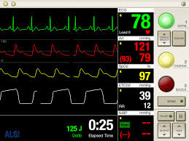
Input / Output
Physiologic monitors are often equipped with alarms that indicate:
  system faults (usually loose or defective electrodes), or
  physiologic parameters that have exceeded the limits set by the operator, or
  both.
Alarms can be set to sound when
measured patient values exceed selectable threshold
©
Physiological Monitor
dr. Chris R. Mol, BME, NORTEC, 2017

Slide 17
Troubleshooting: Common faults
Most common trouble is sensors. Sensors and connection to patient should be verified carefully.
Cables and lead wires should be periodically inspected for breaks and cracks.
Power supply unit can fail (incl. power cables, fuse, …)
Blood pressure pump may fail due to wear-out of membrane
Many devices produce frequent “false alarms” which can lead to alarm fatigue and missed critical events.
Even monitors that are functioning reliably cannot substitute for frequent direct observation
©
Physiological Monitor
dr. Chris R. Mol, BME, NORTEC, 2017

Slide 18
Troubleshooting: Common faults Pulse Oximeter
The use of pulse oximeters can be limited by interference from ElectroSurgical Units, which generate high-frequency signals that can radiate to a pulse oximeter probe and interfere with its operation.
Because they are designed to measure weak light signals transmitted through the skin, the photodetectors in the pulse oximeter sensor can be affected by high-intensity light (e.g., from fluorescent lights) as well as by other light sources such as surgical lights, radiant warmers, bilirubin lights, and sunlight.
Placing an opaque cover over the probe frequently eliminates such interference.
©
Physiological Monitor
dr. Chris R. Mol, BME, NORTEC, 2017

Slide 19
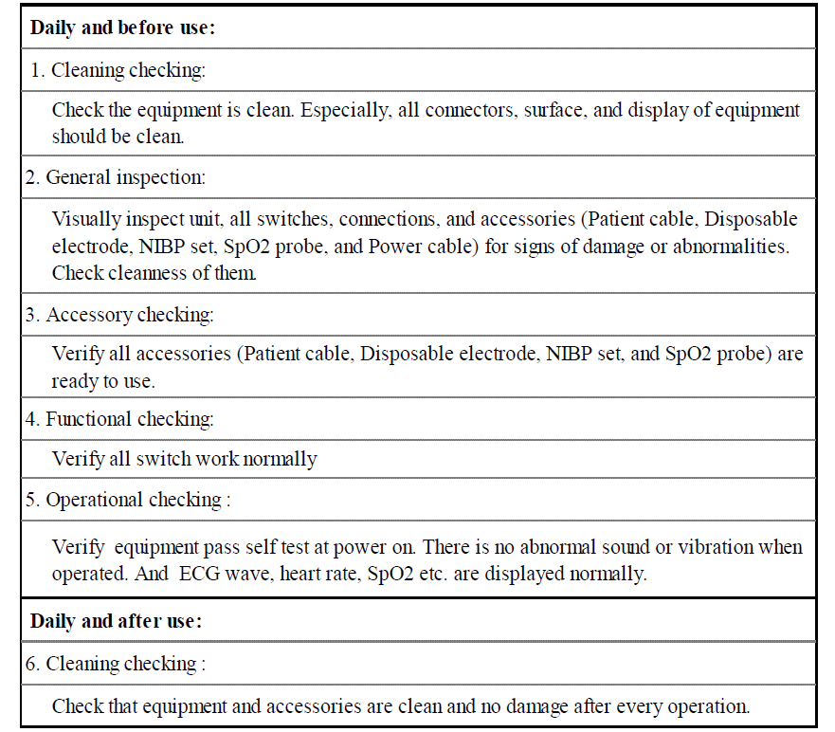
Daily maintenance
Instruction
©
Physiological Monitor
dr. Chris R. Mol, BME, NORTEC, 2017

Slide 20
Safety considerations
electrical safety, alarms, ….
©
Physiological Monitor
dr. Chris R. Mol, BME, NORTEC, 2017

Slide 21

END
The creation of this presentation was supported by a grant from THET:
see https://www.thet.org/

